Slide 1


The Old Man and the Sea
Ernest Hemingway
DR. NIRMALA S. PADMAVAT
BA FY NOTES

Slide 2
Introduction of the Author
The Old Man and the Sea is a novella written by the renowned American author Ernest Hemingway. First published in 1952, it is one of Hemingway's most celebrated works and is considered a classic of American literature. The novella tells the story of an elderly Cuban fisherman named Santiago and his epic struggle with a giant marlin in the Gulf Stream.
Ernest Hemingway was born on July 21, 1899, in Oak Park, Illinois, USA. He had a diverse life, serving as an ambulance driver during World War I and working as a journalist before becoming a prominent writer. Hemingway is famous for his minimalist writing style, characterized by short, simple sentences and a focus on action and dialogue. His works often explore themes of heroism, masculinity, war, and the human condition.
The Old Man and the Sea won Hemingway the Pulitzer Prize for Fiction in 1953 and contributed to his Nobel Prize in Literature in 1954. The novella's compelling narrative and timeless themes have made it a staple in literature classes and a beloved piece of literature for readers of all ages. It continues to be revered for its powerful storytelling and deep philosophical undertones about the resilience of the human spirit in the face of adversity.

Slide 3

Plot
The plot of "The Old Man and the Sea" revolves around an aging Cuban fisherman named Santiago, who has experienced an extended run of bad luck and has gone eighty-four days without catching a fish. The local villagers believe he is cursed, and even his young apprentice, Manolin, has been forced by his parents to leave Santiago and work on a more successful boat.
Determined to prove his worth and restore his reputation, Santiago decides to venture far out into the Gulf Stream, beyond the usual fishing grounds, in search of a big catch. On the eighty-fifth day, he sets out alone in his small skiff, armed with nothing but a few basic tools and his fishing gear.

Slide 4

Plot
After a considerable time without any success, Santiago feels a tug on his line and realizes he has hooked a massive marlin, a giant fish that far exceeds the size of his small boat. Santiago battles the marlin for days, engaging in a grueling and physically demanding contest of strength and willpower. Despite being exhausted, hungry, and faced with numerous challenges, Santiago remains determined to catch the fish.
During the struggle, Santiago reflects on his life, loneliness, and the nature of man's existence. He finds solace in the thought that both he and the marlin are merely doing what they were born to do - fight and survive.

Slide 5

Plot
Finally, Santiago manages to kill the marlin, but he faces another obstacle as he tries to bring it back to the village. The massive carcass attracts sharks, and Santiago valiantly defends his prized catch from their relentless attacks. Despite his best efforts, the sharks devour most of the marlin during the journey home.
Exhausted and defeated, Santiago arrives back at the village with only the marlin's skeletal remains tied to his boat. The sight of the defeated old man and the bones of the great fish sparks sympathy and admiration from the villagers, especially from Manolin, who rekindles his bond with Santiago and vows to never leave him again.

Slide 6

Plot
"The Old Man and the Sea" is a powerful tale of endurance, perseverance, and the indomitable human spirit. Through Santiago's struggle with the marlin, Ernest Hemingway explores themes of resilience, the nature of life and death, and the enduring connection between man and nature. The novella's profound insights and beautiful prose have made it a timeless classic in literature.

Slide 7

Summary
"The Old Man and the Sea" is a novella that unfolds in the fishing village of Cojímar, near Havana, Cuba. The story follows the journey of an elderly and impoverished fisherman named Santiago, who has experienced a prolonged period of bad luck in catching fish. He has gone eighty-four days without catching anything, leading the local community to believe that he is cursed. Santiago's young apprentice, Manolin, who deeply admires the old man's skill and wisdom, has been forbidden by his parents to sail with Santiago anymore.

Slide 8
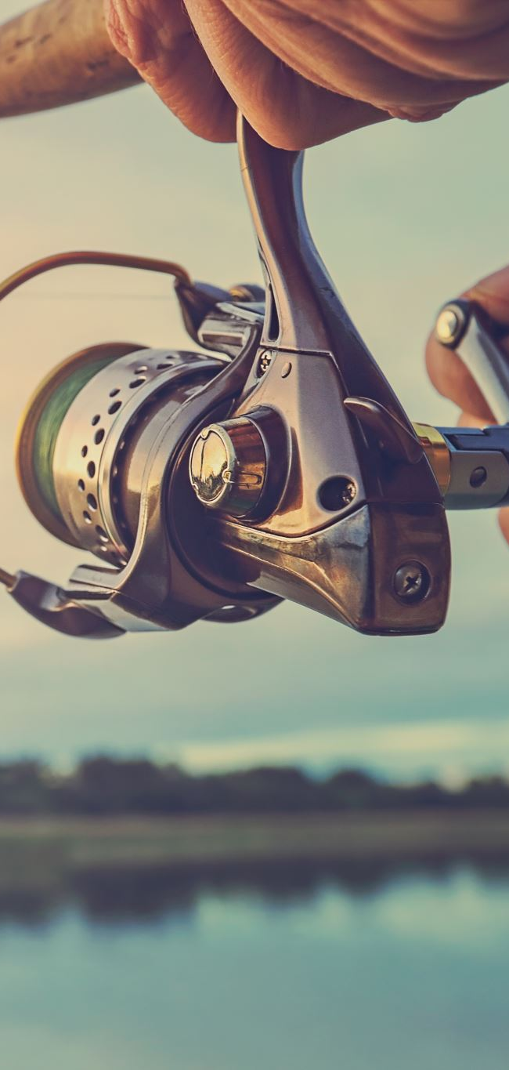
Summary
Undeterred by his failures, Santiago remains determined to prove his worth as a fisherman. On the eighty-fifth day, he sets out alone in his small skiff, far beyond the usual fishing grounds, into the Gulf Stream. Santiago is a seasoned and skilled fisherman, and his respect for the sea and the creatures in it is evident throughout the novella.
After a considerable time without any luck, Santiago finally feels a strong tug on his line and realizes that he has hooked a massive marlin. The fish is enormous, much larger than Santiago's boat, and it puts up an incredible fight. Santiago's hands are cut and bleeding from the struggle to hold onto the fishing line, and his back and legs ache from the strain of trying to control the fish.

Slide 9
Summary
Santiago's battle with the marlin lasts for several days, during which he experiences physical and emotional exhaustion. He talks to himself and to the marlin, showing a sense of camaraderie and respect for the great fish. The old man admires the marlin's strength and determination, even as he knows he must catch it to prove his worth as a fisherman.
During the long, solitary battle at sea, Santiago also reflects on his life, his past successes and failures, and his feelings of isolation and loneliness. He contemplates his identity as a fisherman and what it means to be successful in his chosen profession. Santiago's internal monologues offer profound insights into the human condition and the relationship between man and nature.

Slide 10
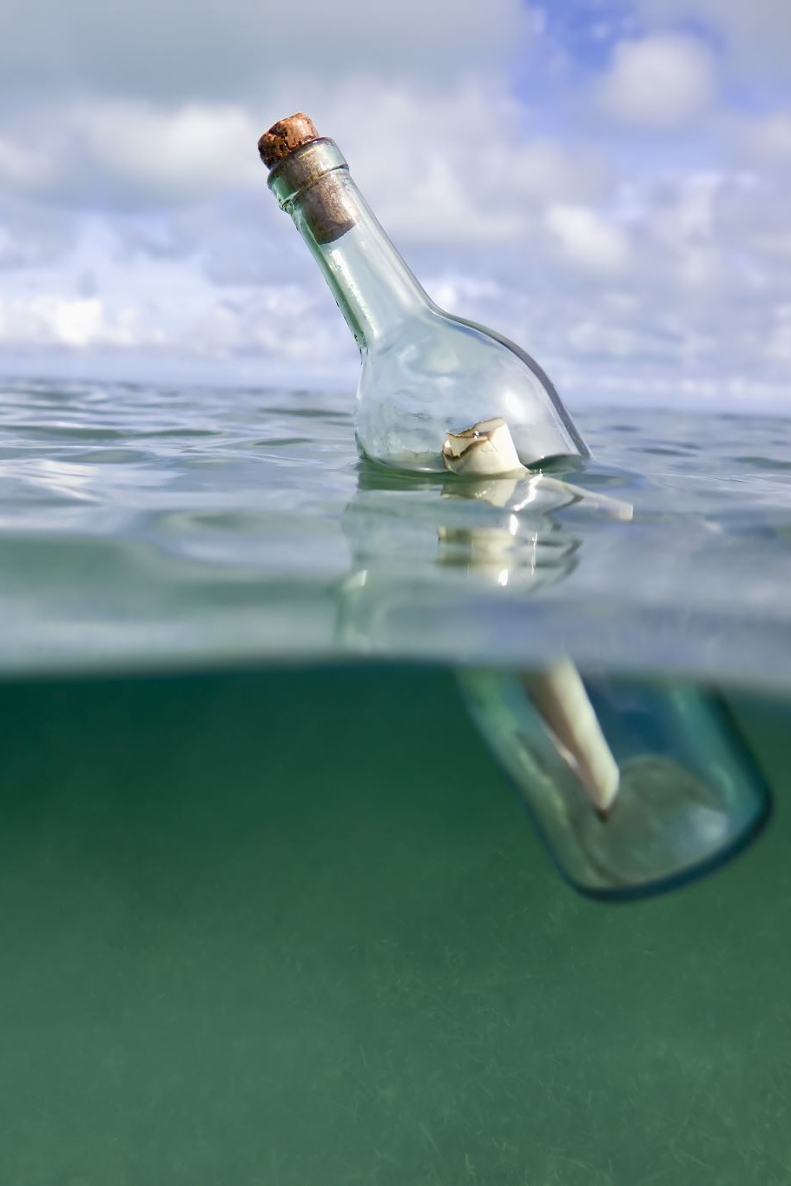
Summary
Finally, Santiago manages to wear down the marlin and harpoons it. He ties the fish to the side of his skiff and begins his journey back to the village, anticipating a hero's welcome. However, Santiago's triumph is short-lived when he encounters a new challenge. A pack of sharks, drawn to the trail of blood from the marlin, attack Santiago's boat, determined to steal his catch.

Slide 11
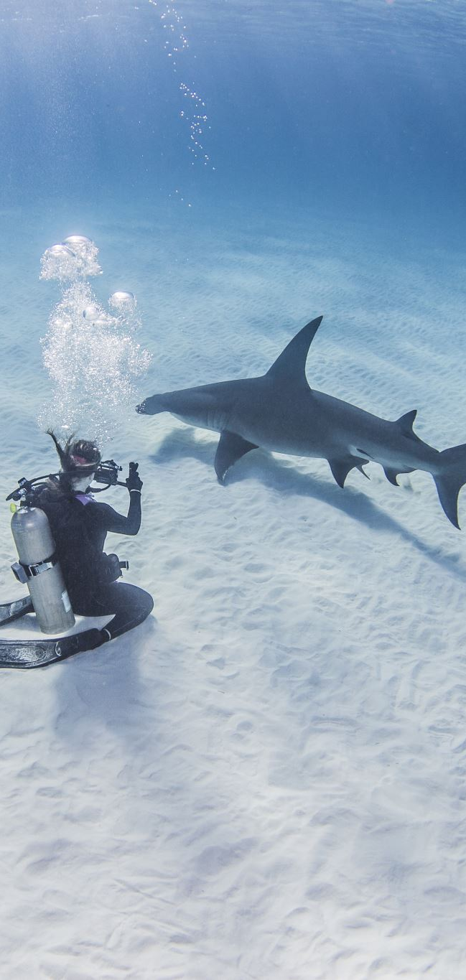
Summary
The old man valiantly fights off the sharks, using a makeshift spear and his remaining strength. Despite his efforts, the sharks devour most of the marlin, leaving only the skeletal remains. Santiago's physical and emotional exhaustion becomes overwhelming, and he returns to the village a defeated man.
Back in Cojímar, the villagers are astonished by the size of the marlin's skeleton and are deeply moved by Santiago's bravery and determination. Manolin, in particular, is overcome with admiration and respect for Santiago. He promises to take care of the old man and expresses his desire to fish with him again, regardless of his parents' wishes.

Slide 12
Summary
"The Old Man and the Sea" is a tale of perseverance, determination, and the resilience of the human spirit. Through Santiago's epic struggle with the marlin and the sharks, Hemingway explores themes of courage, honor, and the relationship between man and nature. The novella's lyrical prose and profound themes have cemented its status as one of Hemingway's most celebrated and enduring works.

Slide 13
Characters
The Old Man and the Sea" primarily revolves around two main characters:
Santiago: Santiago is the elderly Cuban fisherman and the protagonist of the novella. He is often referred to as "the old man." Despite his advanced age and prolonged run of bad luck, Santiago remains a skilled and experienced fisherman. He is depicted as a humble, resilient, and determined individual who is deeply connected to the sea and its creatures. Throughout the story, Santiago's struggle with the giant marlin becomes a metaphor for the human struggle against nature and the indomitable human spirit.

Slide 14

Characters
Manolin: Manolin is Santiago's young apprentice and close companion. He deeply admires the old man's fishing skills and wisdom. Their bond is like that of a father and son, with Santiago teaching Manolin the art of fishing and life's lessons. Manolin is compassionate and caring, and despite his parents' disapproval, he remains loyal to Santiago and wants to fish with him. He represents the youthful admiration and the passing down of knowledge and values from one generation to the next.

Slide 15
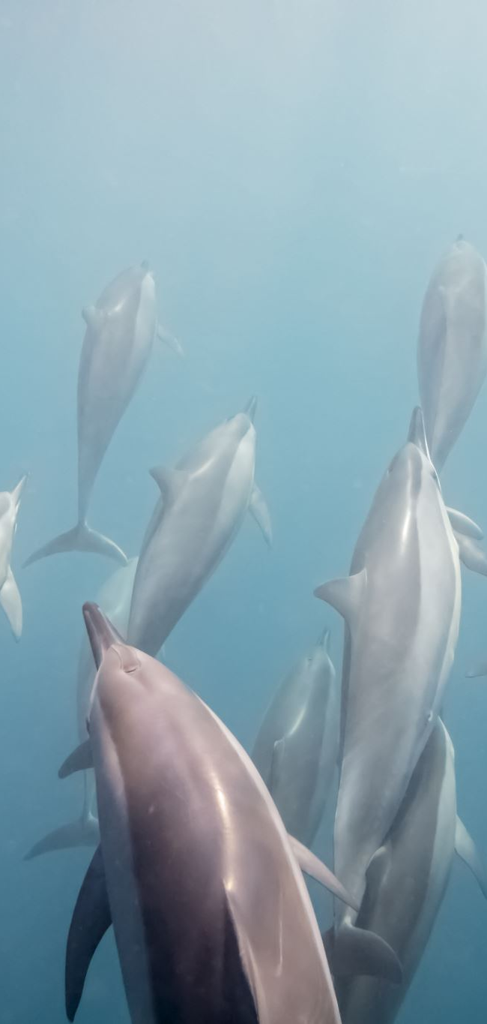
Characters
Other characters, though less prominent, play supporting roles in the novella:
  The Marlin: The giant marlin is the magnificent fish that Santiago hooks during his fishing expedition. The marlin is an awe-inspiring creature, and Santiago admires its strength and determination, even as he tries to catch it. The struggle between Santiago and the marlin becomes the central conflict of the story, symbolizing the epic battle between man and nature.
  The Sharks: After Santiago hooks the marlin and ties it to his boat, he faces a new challenge when a pack of sharks attacks and tries to steal his catch. The sharks represent the relentless forces of nature that can undo even the most significant accomplishments. Santiago's fight against the sharks further highlights his courage and determination.
While these are the key characters in "The Old Man and the Sea," the novella's rich storytelling and symbolic themes evoke a deeper understanding of human nature, resilience, and the interconnectedness of life and nature.

Slide 16

Symbolism
The Old Man and the Sea" is a novella rich in symbolism, with many elements representing deeper themes and ideas. Some of the key symbols in the story include:
  The Sea: The sea itself is a powerful symbol throughout the novella. It represents both the source of life and sustenance for Santiago, as well as the vast and unpredictable forces of nature. The sea embodies both the beauty and the danger of the natural world, and Santiago's deep respect for it reflects his understanding of the interconnectedness of all living things.
  The Marlin: The giant marlin is a symbol of strength, dignity, and nobility. It represents Santiago's worthy opponent and serves as a test of his skill and determination as a fisherman. The marlin also becomes a symbol of Santiago's connection to nature and his respect for the creatures of the sea.

Slide 17
Symbolism
The Sharks: The sharks that attack Santiago's catch symbolize the destructive and predatory nature of life. They represent the forces that can threaten one's hard-earned achievements and success. Santiago's battle with the sharks illustrates the inevitable challenges and setbacks that life presents, even in the face of victory.
Santiago's Hands: Santiago's hands, which become cut and bruised during his struggle with the marlin, symbolize the physical toll of his endeavor. They also represent the sacrifices and hardships that individuals must endure to achieve their goals or to maintain their way of life.
The Lions: In a recurring dream, Santiago sees lions on the beaches of Africa, a symbol of his youth and vitality. The lions represent Santiago's memories of his past and the dreams of his lost youth. They also signify the idea that age does not diminish one's spirit and courage.

Slide 18
Symbolism
Manolin: Manolin symbolizes the next generation and the continuity of knowledge and values. He represents youth, hope, and the passing down of wisdom from the older generation to the younger one. Manolin's unwavering loyalty to Santiago also symbolizes the enduring power of friendship and mentorship.
Santiago's Sail: Santiago's sail, patched together with old newspapers, represents resourcefulness and adaptability. It symbolizes the way he makes the most of what he has, even with limited resources. The sail also embodies Santiago's persistence and his refusal to give up, even in the face of adversity.
The Fisherman's Code: Santiago's adherence to the code of the fisherman reflects his sense of honor and respect for the sea. The code represents a set of principles and ethics that guide Santiago's actions and decisions as a fisherman. It symbolizes his deep understanding of his role in the natural world and his responsibility to act with integrity.

Slide 19
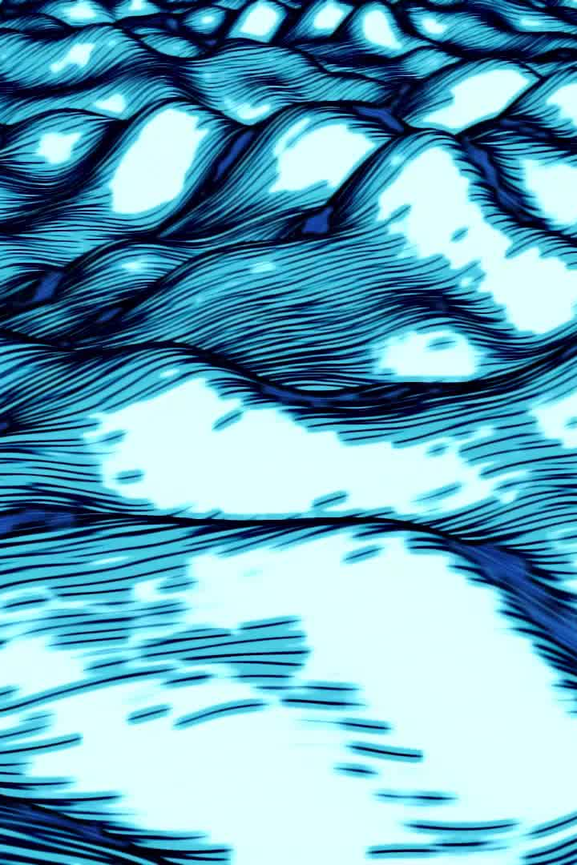
Conclusion
These symbols and their underlying themes contribute to the novella's timeless appeal and its exploration of human nature, resilience, and the relationship between man and nature. Ernest Hemingway's masterful use of symbolism adds depth and complexity to the story, making "The Old Man and the Sea" a powerful and enduring literary work.

Slide 20

Thank you!

